Slide 1

Full Stack Web Development
By:-DR. PARUL MADAN

Slide 2
What is Full Stack...?
Full Stack developer is someone who is familiar with all layers of software development.
These developers aren't expert in everything but simply have the functional knowledge to finish and develop the entire product.

Slide 3
Full Stack Development
Front End Technology
Back End Technology
Database
HTTP & REST
Web Application Architecture
Algorithms & Data Structure
Git Version Control

Slide 4
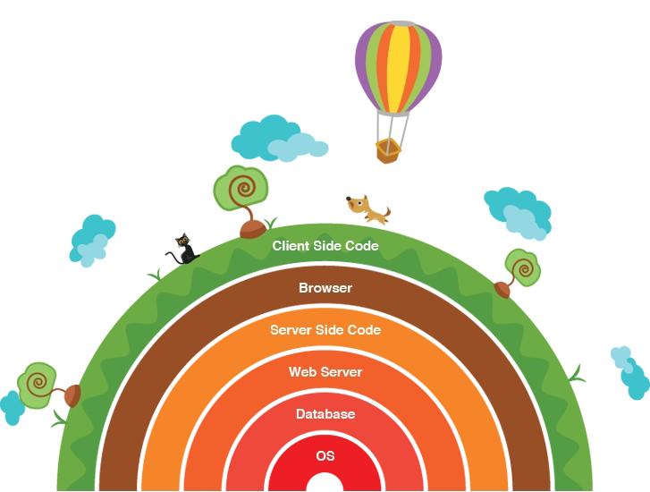
Layers in Full Stack Development...

Slide 5
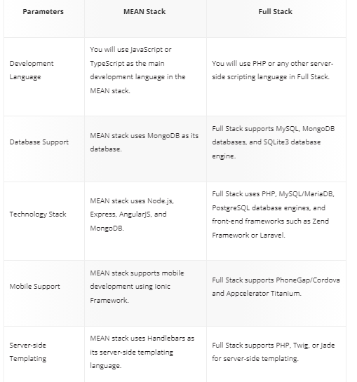

Slide 6
Front End Technologies... (Presentation Layer)
● HTML
● CSS
● JavaScript Libraries such as jQuery, ReactJS, Ajax...
● Frameworks such as Angular, Vue...
● Bootstrap

Slide 7
Back End Technologies... (Business Logic)
● PHP
● Ruby (Ruby on Rails)
● Python (Django, Flask, Pylons)
● Java (Spring)
● Scala (Play)
● NodeJS

Slide 8
Databases Database Technologies...
● MySQL
● PostgreSQL
● MongoDB
● CouchDB
● Redis
● Neo4J

Slide 9
Servers Server Technologies...
● Apache(XAMPP)
● Nginx

Slide 10
3-Tier Architecture
Browser
client
Web
server
Browser sends
URL to web server,
requesting a file or
program
Fetches file or runs
server side (php) script
Apache web server
SQL programming interface:
SQL commands sent
- results returned
PHP
script
1
Server returns results
file and/or program outputs
2
HTML5
CLI for PHP
and mysql
phpMyAdmin
provides separate
browser-based
GUI interface
CSS
HTML: Browser displays (renders)
resulting page
PHP
MySQL
Database
SQL
3
MySQL
JavaScript: executed by browser
jQuery AJAX: ‘direct’ asynchronous web server connection
Javascript
HTTP (developer tools)
AJAX, jQuery notation
JSON, web services
Full stack development
Integrated development
Command Line Interface (CLI)
provides alternative DB interface
mysql commands → performance
php in CLI →error reporting
Notes:
Refer for example to:
http://en.wikipedia.org/wiki/Multitier_architecture [last accessed 8/31/2011]
We generally consider the browser/client as one of the tiers.
Sometimes the web server box above is thought of as two of the layers [with a web server and scripts the server runs].
See such as http://www.webhostinglogic.com/support/support-topics/web-database-3tier.html

